Slide 1
Water Bear Introduction
Software Group
May 2014
C&SI Storage GUI FVT Team
Shen Rui (shenrui@cn.ibm.com)

Slide 2
Agenda
What – What's Water Bear?
Who – Who are using Water Bear?
Why – Why Water Bear?
How – How Water Bear work?
References
Demo
Q & A

Slide 3
What

Slide 4
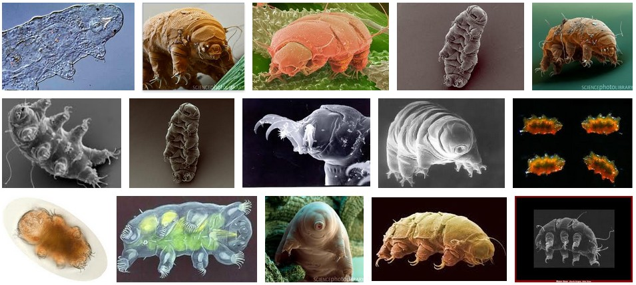
What’s Water Bear?
Water Bear is a Web automation framework built on top of Sahi ( an open source Web automation framework ). Water Bear’s objective is to help teams develop Dojo application Web automation tests more easily and efficiently.

Slide 5
Main Components
Framework
  The infrastructure which all the automation test cases run in
Appobjs CodeGen
  Sahi scripts to generate the source code for Appobjs layer by traversing DOM tree
Recorder
  Sahi scripts to record all the actions/data and generate Water Bear – style source code

Slide 6
Features
Multiple Language Support
  Load all UI texts from Resource Bundle files
Logging
  Leverage Log4J
Test Case Management
  Leverage TestNG
Build/Task Management
  Leverage ANT
Screeshots on Failure
  Leverage FEST
XML-based Test Data Management
  Leverage XStream
SSH Support
  Leverage JSCH
E-mail Integration
  Leverage ANT Mail task

Slide 7
Who

Slide 8
Who are using Water Bear?
CS&I Storage GUI FVT team
  Products: Storwize V7000, SVC, Flash System, etc.
TS7700 FVT team
  Use Water Bear to automate the test cases that RFT cannot do

Slide 9
Why

Slide 10
Challenges to automate Dojo applications
Coding Phase
  Ajax
    To handle Ajax responses, write lots of Hardcode Time Wait and Conditional Wait
  Product complexity
    Spend lots of time to write the code to identify UI elements
  No static identifiers/Dynamic Ids
    Don't know how to identify UI elements
  Dojo complexity
    Make the automation code more complex
Maintenance Phase
  Frequent UI changes
    Automation code have to change frequently
  Dojo upgrade
    Dojo widget DOM changes may also bring automation code changes

Slide 11
How does Water Bear handle the challenges?
Challenges
Water Bear
Development
Ajax
Implicit Waiting
Product Complexity
Code Generation
Dojo Complexity
Widgets
Maintenance
Dynamic Ids
Various Finding Methods
UI Changes
Positional Relation
Dojo Upgrade
Responsibility Isolation

Slide 12
Responsibility Isolation
Test Cases
Handle the big product functional changes
Tasks
Handle the small product functional changes
AppObjects
Handle UI control changes
Widget Finder
Handle the methods to construct Widgets
Widgets
Handle Dojo widget changes
Widget Registry
Handle the way to define Widgets
Propagation of changes are prevented!

Slide 13
Code Generation
Coding Effort Distribution
Test Cases
1/3
1/3
Tasks
AppObjects
Code Generator
AppObjects
generate
1/3(+)
1/3+ coding effort is saved!

Slide 14
Positional Relation (In, Near, Under, etc.)
div
div
div
In
div
div
div
div
div
Near
label
label
label
label
Insensitive to DOM structure changes

Slide 15
How does Water Bear handle the challenges? (Explanation)
Coding Phase
  Ajax
    Water Bear supports Implicit Waiting, Conditional Waiting and Hardcode Time Waiting. Most of scenarios can be handled implicitly.
  Product complexity
    Water Bear Appobjs Code Generator can generate Appobjs classes
  No static identifiers/Dynamic Ids
    Water Bear provides various methods to locate UI elements – by label, by attributes, by index, etc.
  Dojo complexity
    Water Bear widgets encapsulate the Dojo widgets behaviors
Maintenance Phase
  Frequent UI changes
    Water Bear support Positional Relation, which results in the less automaton code changes when the product UI change
  Dojo upgrade
    Water Bear widgets ensure the minimal impacts caused by Dojo widget changes to the other parts of the automaton code

Slide 16
Why Water Bear?
Less Coding Effort
  Flexible and powerful methods to locate UI elements: by element label, by element attributes, by element index, etc.
  Sahi can handle 80%-90% AJAX requests waiting implicitly
  Code generator saves you more than 1/3 coding effort
Less Maintenance Effort
  Less effort to handle Dojo upgrade by encapsulating each Dojo widget's DOM structure and operations in one Java class (i.e. Water Bear Widgets)
  Less effort to handle product UI changes by leveraging Sahi's Positional Relation methods (i.e. in, near and under) and ITCL layered design

Slide 17
How

Slide 18
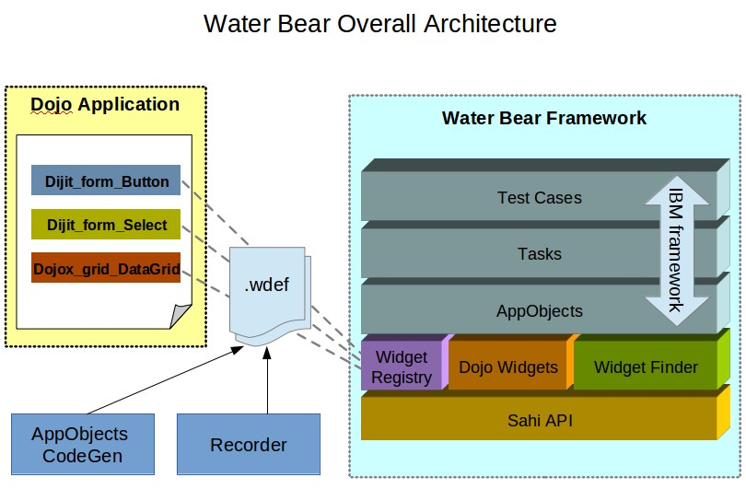
Overall Architecture

Slide 19
IBM framework (ITCL framework)
The IBM framework, formerly known as the ITCL framework, was developed by the Quality Software Engineering team in collaboration with experienced automation teams throughout IBM. The framework consists of a three-tiered architecture implemented through the appobjects, tasks, and test cases packages (the IBM package).
AppObjects: where you will store information about your application’s GUI elements. It is also where you will write your Getter Methods, which return objects enabling the Caller to query and manipulate these GUI elements. Typically, these methods are called within the Task layer.
Tasks: where you will write reusable methods that exercise common functions in your application. It is also where you will write methods to manipulate and query complex, application-specific controls. Methods in the Task are called by Test Cases.
Test Cases: methods that navigate through an application, verify its state, and log results.

Slide 20
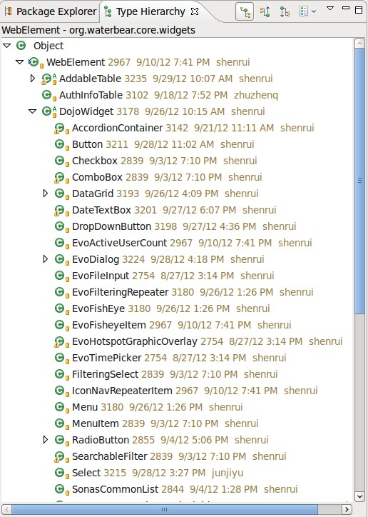
Water Bear Widgets
Three types of Water Bear widget:
Standard HTML elements, like div, span, etc.
  Represented by WebElement.java
Dojo Widgets
  Sub-classes of DojoWidget.java
  29 Dojo standard widgets and 29 Evo standard widgets so far
Reusable HTML Fragment
  No widgetid attribute or no useful widgetid attribute to create a Dojo Widget
  Sub-classes of WebElement.java

Slide 21
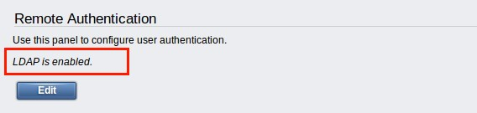

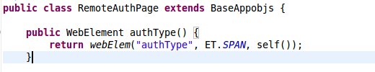
Standard HTML Element
User Interface
DOM Structure
Water Bear Source Code

Slide 22
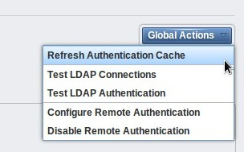
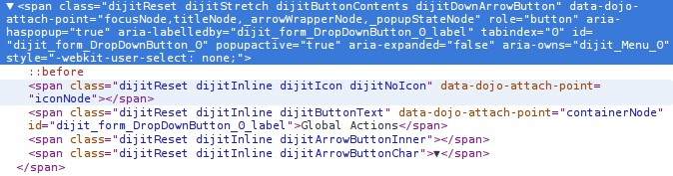
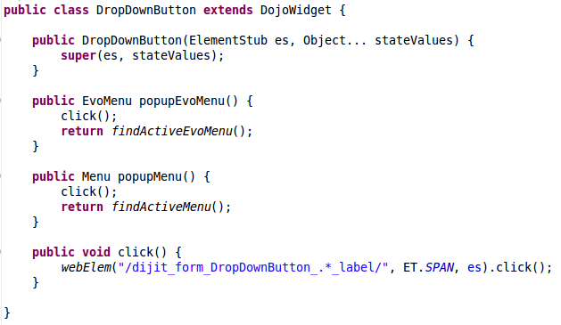

Dojo Widgets
DOM Structure
User Interface
Widget Source Code
Widget Usage Code

Slide 23
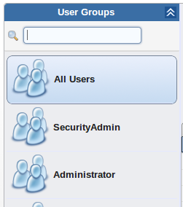
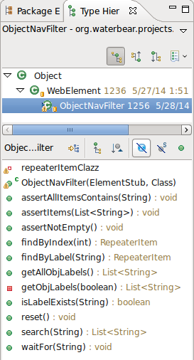
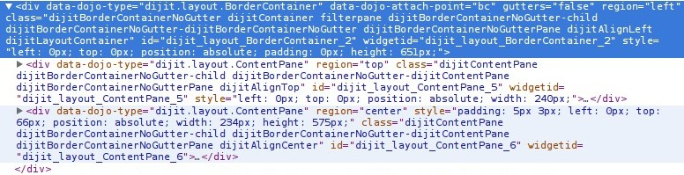
Reusable HTML Fragment
Widget Source Code
User Interface
DOM Structure

Slide 24
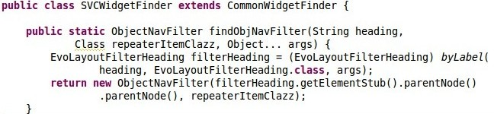

Reusable HTML Fragment (Cont.)
The method in Widget Finder
The method in AppObjs class

Slide 25
Widget Registry
Widget Registry is a bridge between Web world (Dojo application) and Java world (Water Bear)
Widget Registry loads the widget definition information from .wdef files when the GUI automation program initializes
Test Case layer
Tasks layer
Appobjs layer
Widget Finder
Widget Registry
.wdef
.wdef

Slide 26
Widget Definition Files (.wdef files)
Widget definition files are plain text files used to map the Water Bear widgets to
Dojo widgets. One Water Bear widgets may map to multiple Dojo widgets.
Format
[1] = [2]|[3]|[4]|[5]
[1] Full qualified Class name
[2] Widget element type: the type of enclosing element
[3] Core element type: the type of the element whose id attribute value is identical to the Widgetid
attribute value of the Dojo widget
[4] Label position: the position of the label to the Dojo widget
[5] Mapped Dojo Widget id prefixes: separated by comma if more than one Dojo widget map to
one Java class
* For [2] and [3], the valid element type values are defined in org.waterbear.core.widgets.ET.
* For [4], the valid values are: labelinside, labeloutside, labelnear and none. They are defined in
org.waterbear.core.widgets.registry.RegEntry.
Sample
org.waterbear.core.widgets.dijit.Textbox=div|textbox|labelnear|dijit_form_ValidationTextBox,
evo_form_ObjectNameTextBox,dijit_form_NumberTextBox
org.waterbear.core.widgets.dijit.Checkbox=div|checkbox|labelnear|dijit_form_CheckBox
org.waterbear.core.widgets.dijit.Select=table|table|labelnear|dijit_form_Select
org.waterbear.core.widgets.dijit.Button=span|span|labelinside|dijit_form_Button
org.waterbear.core.widgets.dijit.ComboBox=div|textbox|labelnear|dijit_form_ComboBox

Slide 27
Widget Definition Files (.wdef files) – How to extend
Core.wdef
  Define the standard Dojo widgets and Evo widgets
Project_specific.wdef
  Define the project specific widgets
How to extend a widget definition?
Core.wdef
Project_specific.wdef
org.waterbear.core.widgets.evo.EvoPresetChooser=div|div|labelnear|evo_widget_PresetChooser2
org.waterbear.core.widgets.evo.EvoPresetChooser=aspen_cs_FCMapPresetChooser

Slide 28
Widget Finder
byLabel(String,Class,Object…)
  Create a Water Bear widget instance based on the specified label text
Example: byLabel("Filter", Button.class, getToolbar())
byAttribute(String,Class,Object…)
  Create a Water Bear widget instance based on the attribute values of core element of the specified widget class
  Support attributes array
Example: byAttribute("iogrp0", Checkbox.class, self())
byAttribute("{name:'nameValue',className:'classValue'}", Textbox.class, self())
byIndex(int,Class,Object…)
  Create a Water Bear widget instance based on the specified index
Example: byIndex(0, DataGrid.class, self())
webElem(Object,String,Object…)
  Create a WebElement instance based on the passed in parameters. This method is used to create Java presentations for DIV, SPAN, etc.
  Support attributes array
Example: webElem("/dijitDialogPaneActionBar.*/", ET.DIV, es)
webElem("{id:'messageBox',className:'messagesBox'}", ET.DIV, es)

Slide 29
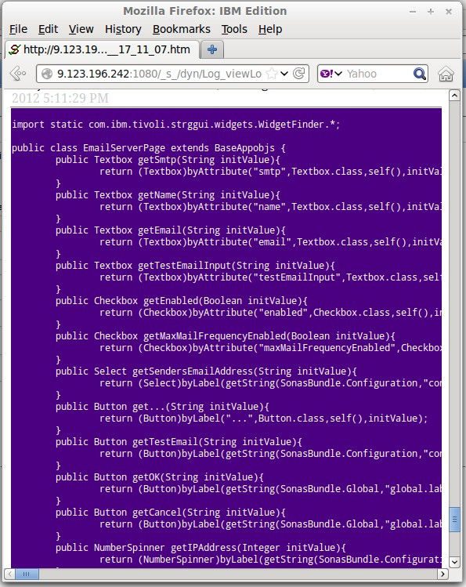
AppObjects Code Generator
Developed using Sahi script
Intelligently generate Page and Dialogue classes source code
Automatically find the property key in the resource bundle files for the given text
Easy-customized to work for a new project

Slide 30
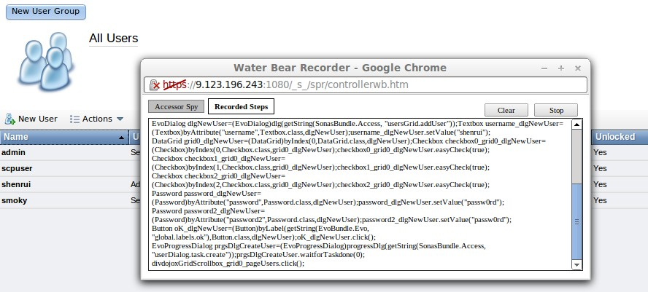
Recorder
Sahi scripts to record all user actions/data and generate Water Bear – style source code
Multiple-language is supported
Easy-customized to work for a new project

Slide 31
Test Data Manager
Test data can be managed in XML files or in the Java classes
  Environment/hardware/system dependent test data is better to be managed in files
  XML file can support complex structure data
XML test data is generated automatically when the test case run at the first time
  No manual effort to generate the first version of test data
Support user specified directory to load test data
  Means one set of test cases can work with different sets of test data
Data is serialized/de-serialized using XStream (an open source software)

Slide 32
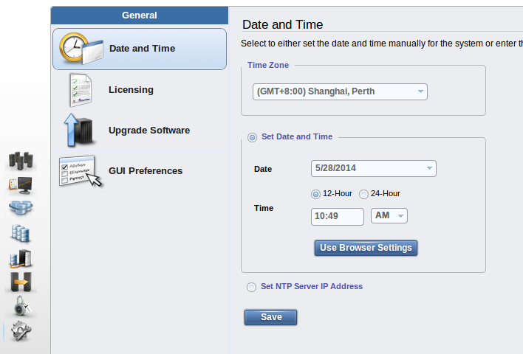
Code Snippet – Date and Time

Slide 33
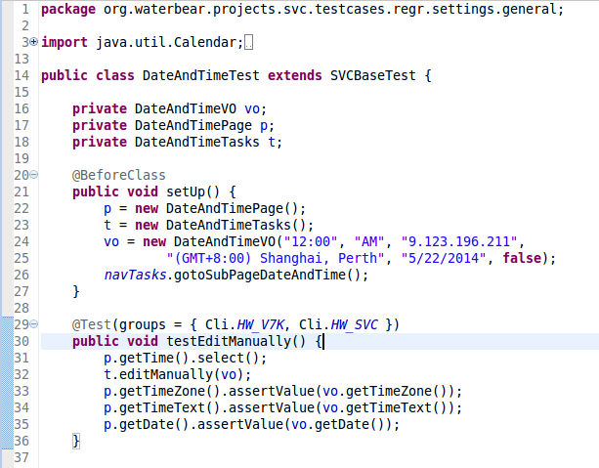
Code Snippet – DateAndTimeTest.java

Slide 34
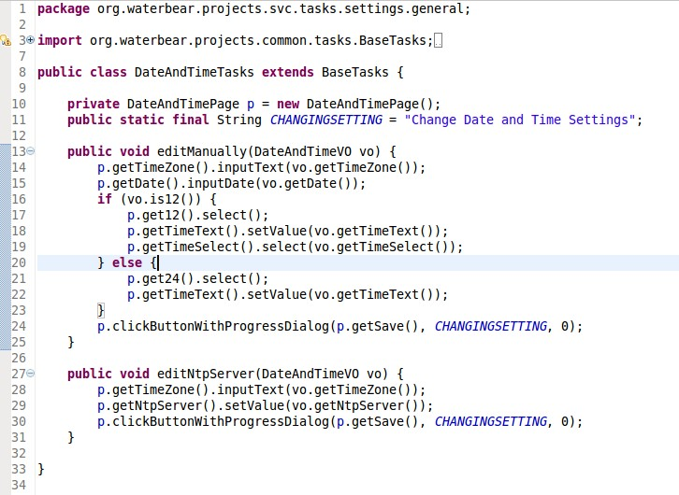
Code Snippet – DateAndTimeTasks.java

Slide 35
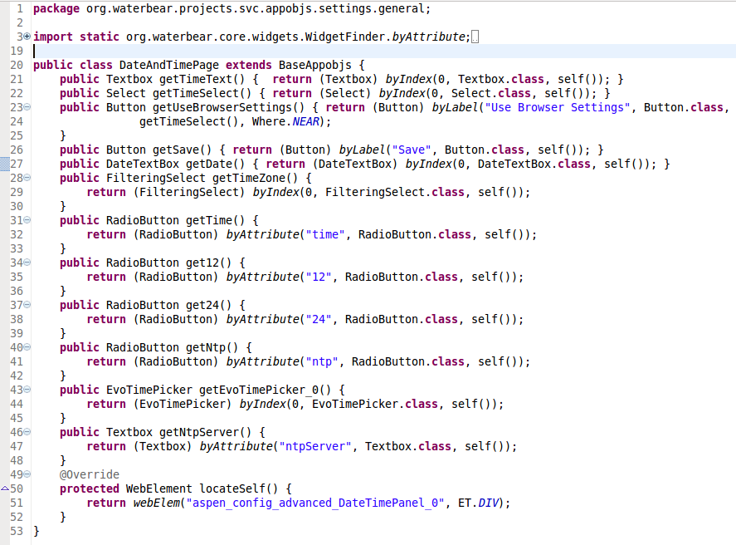
Code Snippet – DateAndTimePage.java

Slide 36
On-line resources
Water Bear Community
  Water Bear Introduction (online version)
  Water Bear CodeGen Demo - A 9 minutes video to demonstrate how to leverage AppObjs CodeGen and Skelenton CodeGen to develop a test case in a few minutes
  Water Bear Recorder Demo - A 7 minutes video to demonstrate how to use Water Bear Recorder to develop a test case of creating/editing/deleting a user in a few minutes
  Instructions, guides, etc.
My articles about Sahi and Water Bear
  《谈 Dojo 应用的 UI 自动化测试》
  《使用Sahi测试Dojo应用》
  《利用Sahi脚本自动生成代码加速Web自动化测试开发》
  《Sahi案例分享：音乐批量下载》
Join the Water Bear Community to keep getting latest news

Slide 37
References
Sahi - http://sahi.co.in/w/
TestNG - http://testng.org/doc/index.html
Ant - http://ant.apache.org/
XStream - http://xstream.codehaus.org/
Log4J - http://logging.apache.org/log4j/1.2/
FEST - http://code.google.com/p/fest/
CodeModel - http://codemodel.java.net/

Slide 38
Demo
Notes:
Demo three layers – appobject, tasks, test cases
Demo the widgets and widget wdef files and widget finder
Demo the codegen

Slide 39
Q & A

Slide 40
Backup Slides

Slide 41
Future
Continue simplifying the AppObjs layer coding
  Firefox plugin to generate/edit AppObjs layer code
  Eclipse plugin to support drag/drop code generation
Recorder to generate modularized code

Slide 42
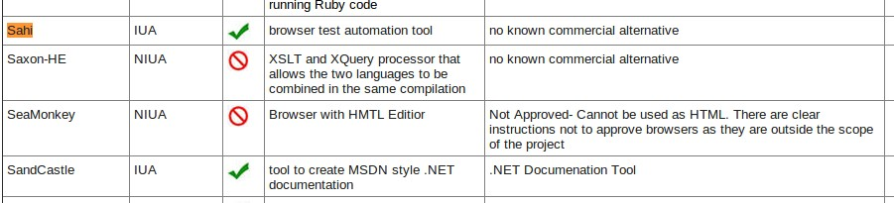
Legal Approval
Sahi is listed in G2O software so it could be used internally in IBM without legal issue.
Current Listing of G2O Software

Slide 43
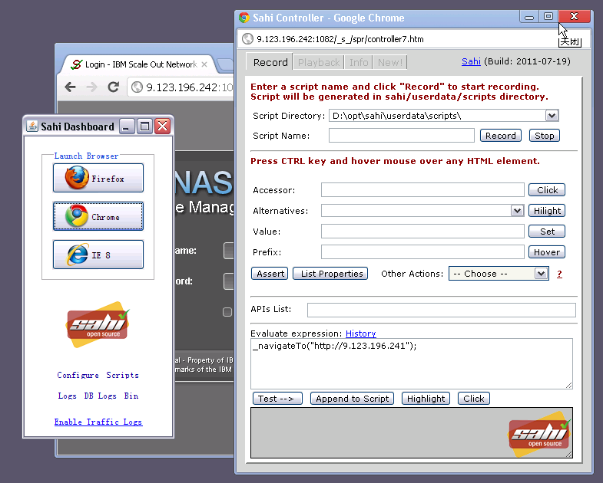
Sahi Dashboard/Controller

Slide 44
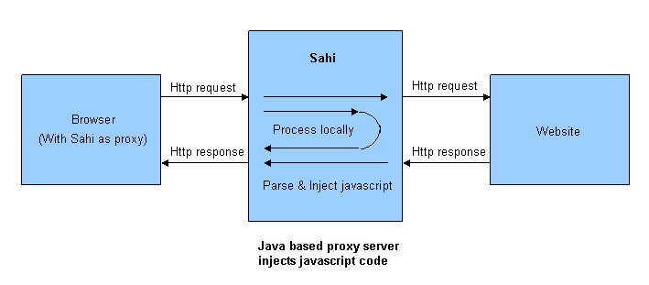
How Sahi works?

Slide 45
Skeleton Code Generator
Developed using Java (leveraging CodeModel – an open source software)
Generate code of VO(Value Objects) classes, Tasks classes and Test Case classes
Three patterns:
  Page Edit pattern
  Dialogue Edit pattern
  Dialogue New/Edit pattern
The generation pattern is detected automatically from the AppObjects class passed in

